Slide 1


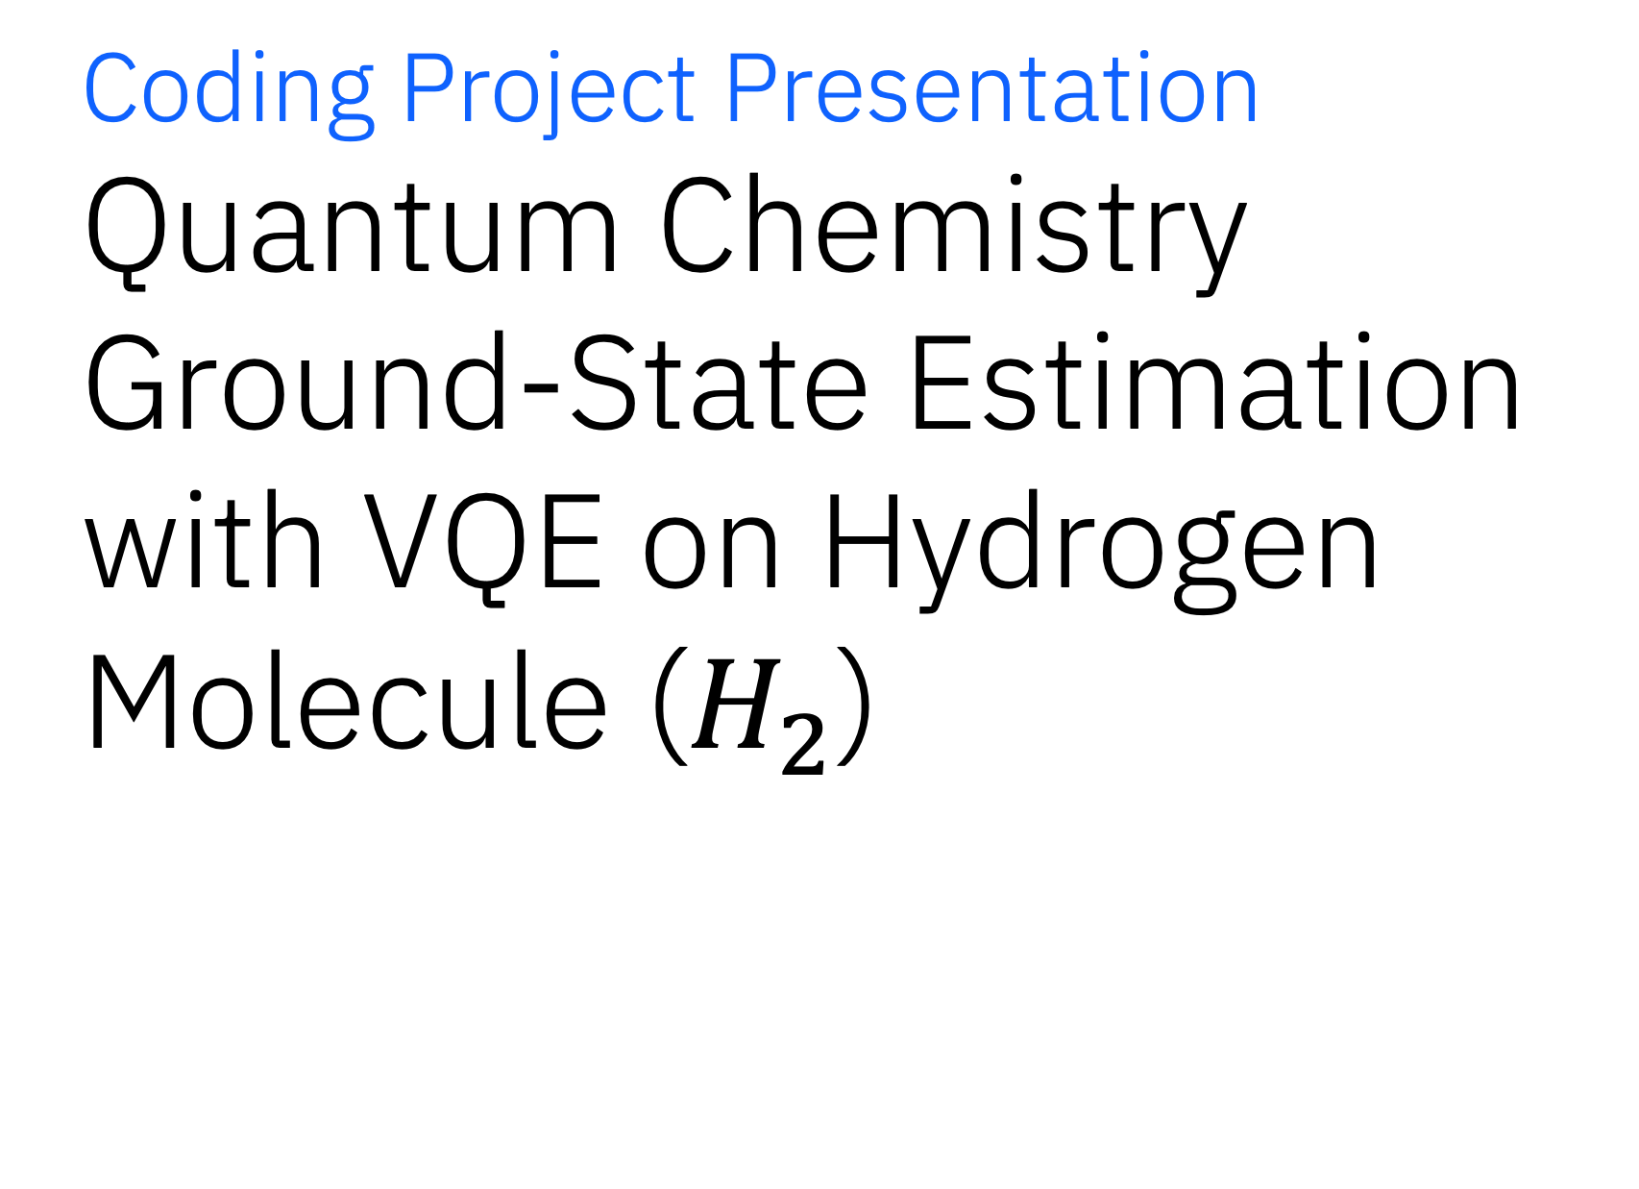
University of Southern California
Coding Project Presentation Quantum Chemistry Ground-State Estimation with VQE on Hydrogen Molecule ($H_{2}$)
EE520 – Quantum Information Processing
Rishwi Thimmaraju
Instructed by - Dr. Todd Brun

Slide 2
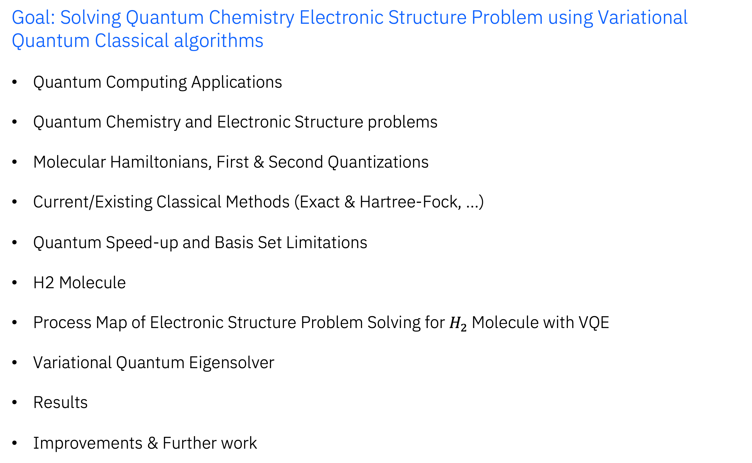
Contents
Goal: Solving Quantum Chemistry Electronic Structure Problem using Variational Quantum Classical algorithms
Quantum Computing Applications
Quantum Chemistry and Electronic Structure problems
Molecular Hamiltonians, First & Second Quantizations
Current/Existing Classical Methods (Exact & Hartree-Fock, …)
Quantum Speed-up and Basis Set Limitations
H2 Molecule
Process Map of Electronic Structure Problem Solving for $H_{2}$Molecule with VQE
Variational Quantum Eigensolver
Results
Improvements & Further work

Slide 3
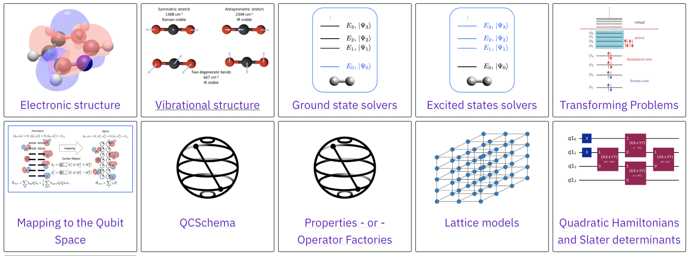
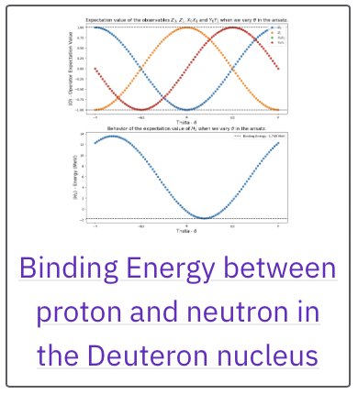
Applications of Quantum Computing
Applications | work
Computer Algorithms, processes, and methods | Shor’s Algorithm BB84 QKD Grover’s Algorithm Quantum Phase Estimation
Quantum Chemistry | Electronic Structure problem Ground State and Excited State energies Reaction Mechanisms
Quantum Machine Learning | Quantum Neural Networks Quantum-Classical Classifiers Quantum Kernel Methods
Quantum Finance | Portfolio Optimization Value-at-Risk Calculations
Quantum computing in High Energy Physics Uncover useful data from Clients to help them succeed Uncover ideas for revenue generation and upselling uncover useful data from clients to help them succeed? | Simulating Particle Interactions Lattice Gauge Theories
Quantum computing in Healthcare and Life Sciences Client informed content creation Organize internal collaboration on projects | Drug Discovery Protein Folding
Quantum computing in Material Science Propose strategies to other teams Get buy-in from other teams collaborate with other teams | Defect characterization in semi conductors Magnetic properties and band structure in Condensed Matter Physics
Quantum Simulations | Spin Chains and Lattice Models Molecular dynamics Open Quantum Systems Many-body Physics
Quantum Optimization | Travelling Salesman Problem 3-SAT problem Logistics Optimization(Flight route optimization, …) Max-Cut

Slide 4
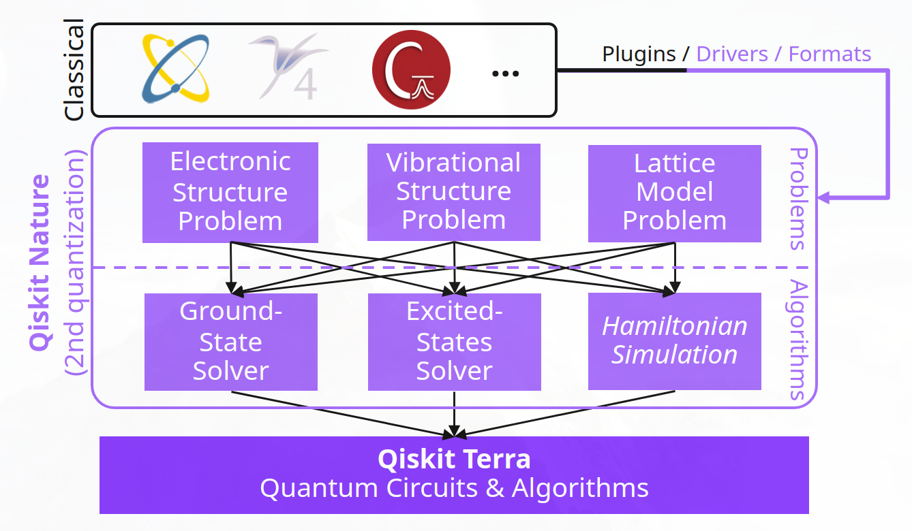
Quantum Chemistry & Electronic Structure Problems
The electronic structure problem involves solving the Schrödinger equation to determine the behavior of electrons in a molecule
Key Quantities that can be Derived are:
Ground-State Energy (GSE): Determines molecular stability and chemical reactivity.
Excited-State Energies: Critical for photochemistry and understanding light-matter interactions.
Bond Lengths and Angles: Helps optimize molecular geometries for chemical and biological studies.
Electron Correlation: Explains phenomena like magnetism and superconductivity.
Current State-of-the-art Applications:
Electron Transfer in Biomolecules
Accurate modeling of electron movement in large biomolecules, such as DNA, helps in understanding mutations and their role in diseases.
Insight into repair mechanisms for designing effective treatments.
Simulating Energy Storage Materials
Understanding GSE in new materials for developing efficient batteries and fuel cells.
And more…

Slide 5
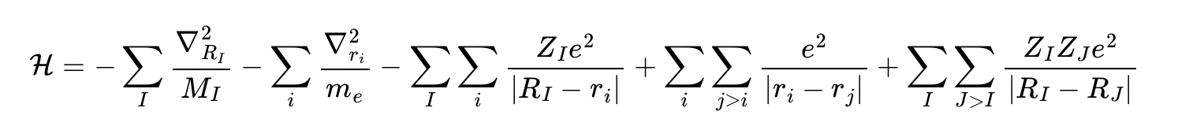
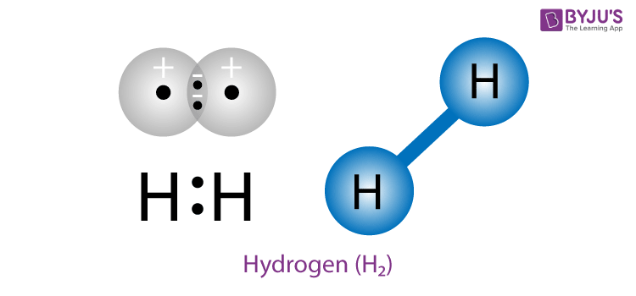
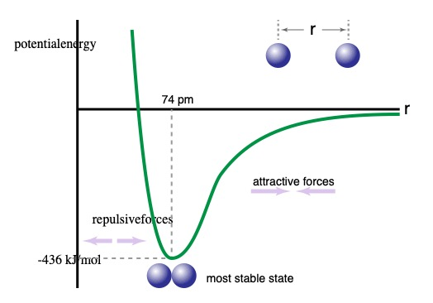
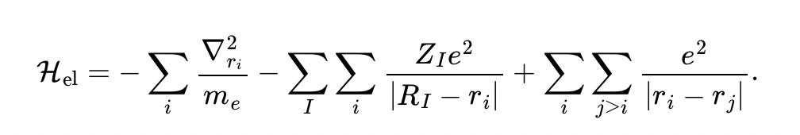
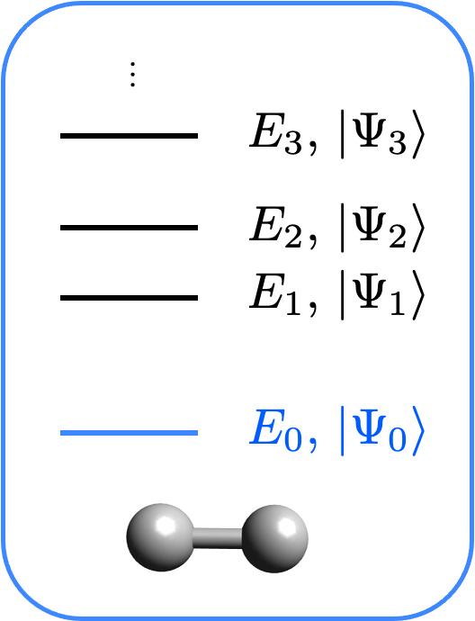
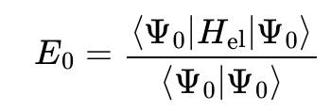

First
Quantization
Molecular Hamiltonian
RI​: The position vector of the I-th nucleus in the molecule.
ri​: The position vector of the i-th electron in the molecule.
Kinetic energy of Nuclei
Nucleus-Electron Coulomb repulsion
Nucleus-Nucleus Coulomb repulsion
Kinetic energy of Electrons
Nucleus-Electron Coulomb attraction
First Approximation:
Because the nuclei are much heavier than the electrons they do not move on the same time scale and therefore, the behavior of nuclei and electrons can be decoupled. This is the Born-Oppenheimer approximation.
Ground State Energy ($|Ψ_{0}⟩$)
However, the dimensionality of this problem grows exponentially with the number of degrees of freedom. To tackle this issue we would like to prepare $|Ψ_{0}⟩$ on a quantum computer and measure the Hamiltonian expectation value (or ) directly.

Slide 6
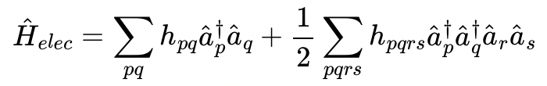
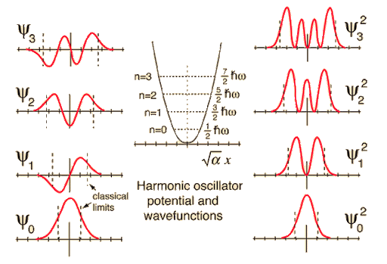
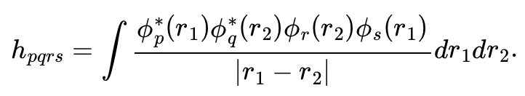
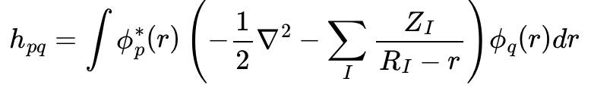
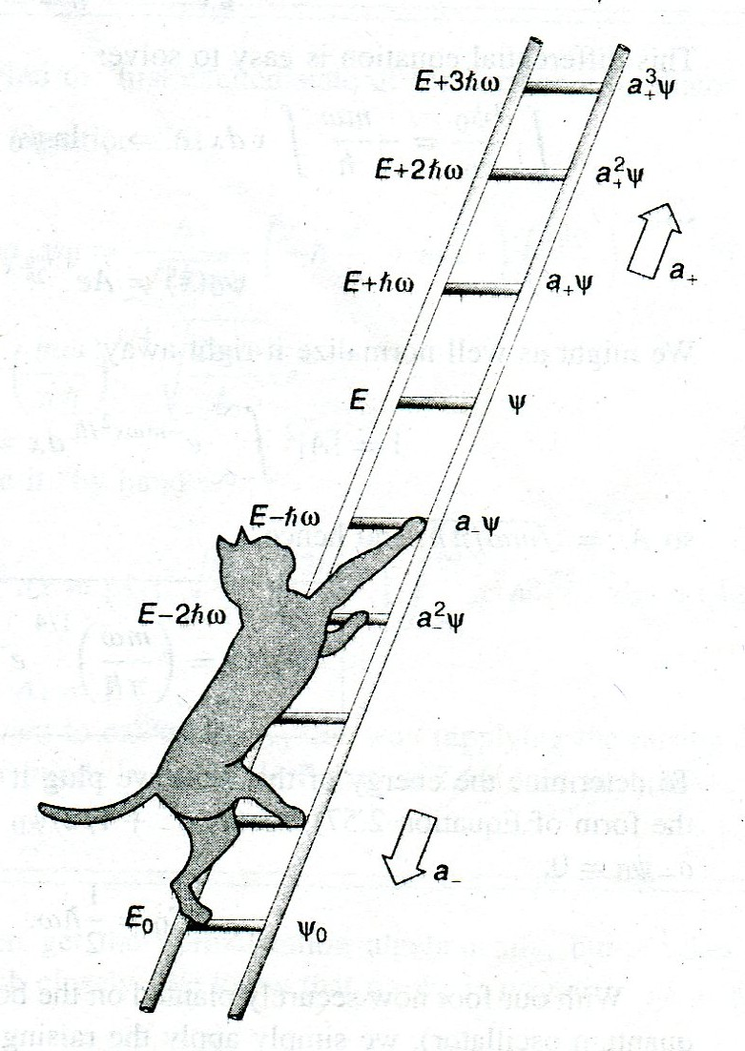
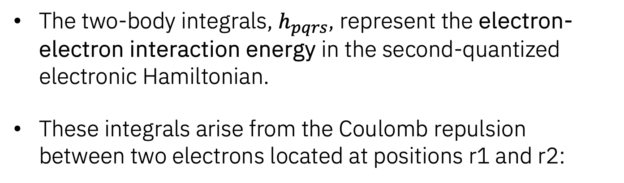
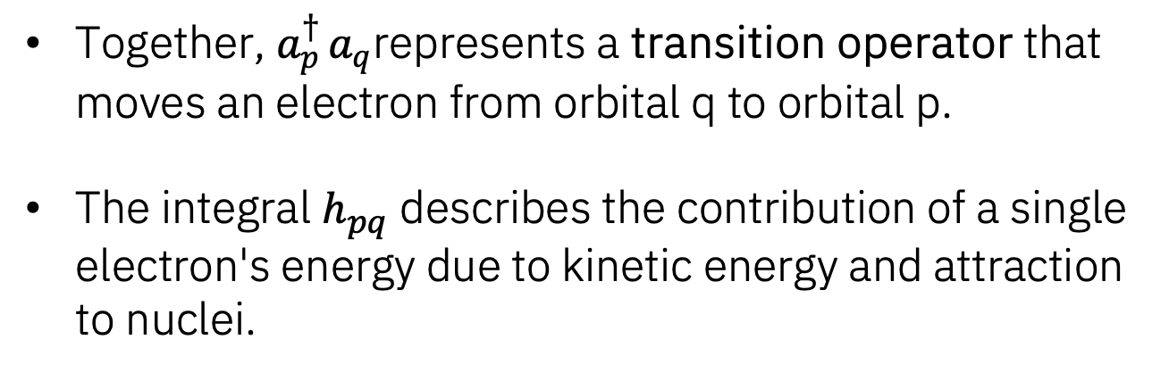
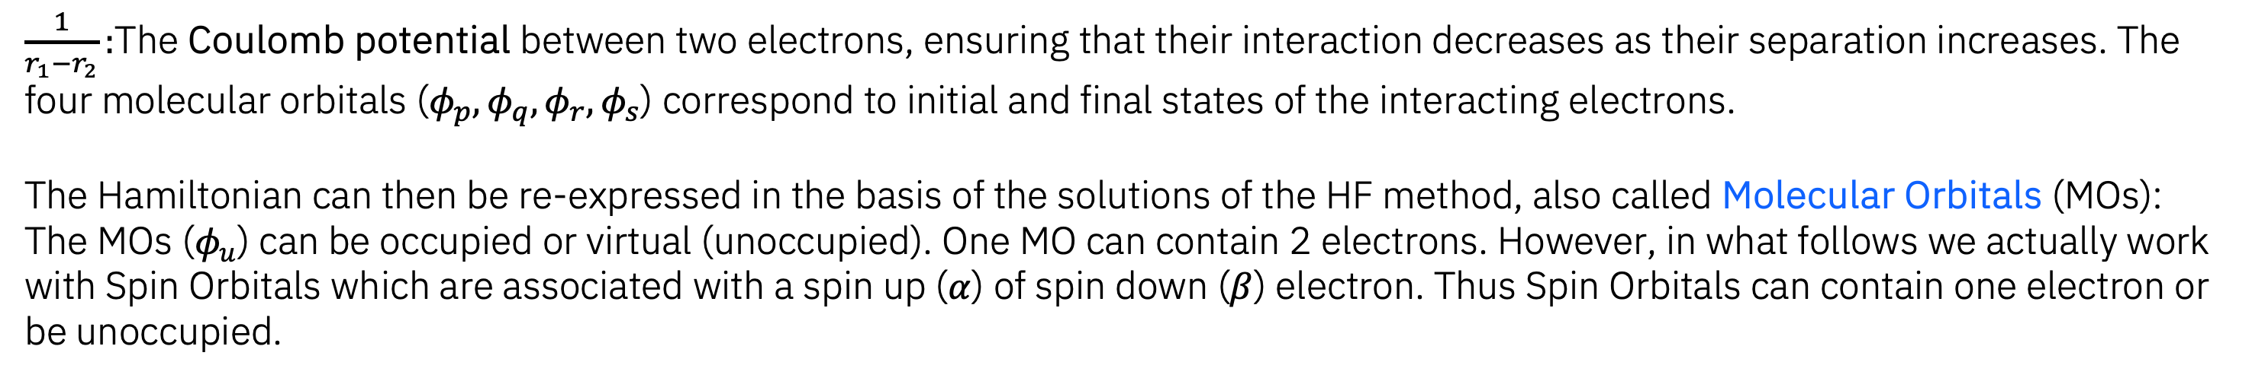
Second
Quantization
A good starting point for solving this problem is the Hartree-Fock (HF) method. This method approximates the N-body problem by N one-body problems where each electron evolves in the mean-field of the others. Classically solving the HF equations is efficient and leads to the exact exchange energy but does not include any electron correlation. Therefore, it is usually a good starting point to which to add correlation.
One-Body Integrals
Two-Body Integrals
Kinetic energy
Attraction to Nuclei
Together, $a_{p}^{† }a_{q}$represents a transition operator that moves an electron from orbital q to orbital p.
The integral $h_{pq}$​ describes the contribution of a single electron's energy due to kinetic energy and attraction to nuclei.
The two-body integrals, $h_{pqrs}$​, represent the electron-electron interaction energy in the second-quantized electronic Hamiltonian.
These integrals arise from the Coulomb repulsion between two electrons located at positions r1​ and r2:
$\frac{1}{r_{1}−r_{2}}:$The Coulomb potential between two electrons, ensuring that their interaction decreases as their separation increases. The four molecular orbitals ($φ_{p},φ_{q},φ_{r},φ_{s}$) correspond to initial and final states of the interacting electrons.
The Hamiltonian can then be re-expressed in the basis of the solutions of the HF method, also called Molecular Orbitals (MOs):
The MOs ($φ_{u}$) can be occupied or virtual (unoccupied). One MO can contain 2 electrons. However, in what follows we actually work with Spin Orbitals which are associated with a spin up ($α$) of spin down ($β$) electron. Thus Spin Orbitals can contain one electron or be unoccupied.

Slide 7
Current / Existing Classical Methods
Exact Diagonalization
Provides the exact solution to the electronic Schrödinger equation within a chosen basis set.
Computational cost grows exponentially with the size of the system.
Used for small molecules to benchmark other methods.
Hartree-Fock
Approximates the N-electron wavefunction as a single Slater determinant.
Captures mean-field interactions but neglects electron correlation.
Often used as the starting point for more advanced methods.
Density Functional Theory
Models the ground-state energy as a functional of the electron density.
Includes electron correlation through exchange-correlation functionals.
Widely used due to its balance between accuracy and computational efficiency.
Post Hartree-Fock Methods
Møller-Plesset Perturbation Theory
Configuration Interaction (CI)
Coupled Cluster (CC)
Expands the wavefunction using exponential operators.
Highly accurate; CC with singles, doubles, and perturbative triples (CCSD(T)) is the gold standard for many systems.
Limitations
Many methods fail to scale efficiently with system size.
Accuracy depends on the choice of basis set and approximations (e.g., DFT functional).
Classical methods, while effective for small or moderately sized systems, are fundamentally limited by computational scaling and approximation accuracy.
Notes:
Ryan King (BD for DCX) helps determine the system they buy

Slide 8
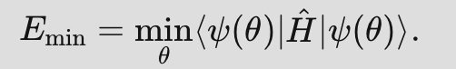
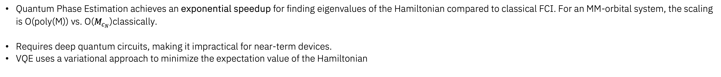
Quantum Speed-Up & Basis Set limitations
Quantum Phase Estimation achieves an exponential speedup for finding eigenvalues of the Hamiltonian compared to classical FCI. For an MM-orbital system, the scaling is O(poly(M)) vs. O($M_{c_{N}}$)classically.
Requires deep quantum circuits, making it impractical for near-term devices.
VQE uses a variational approach to minimize the expectation value of the Hamiltonian
Basis Sets
Basis sets are a set of mathematical functions used to represent the wavefunctions of electrons in quantum chemistry calculations.
Wavefunctions are expressed as a linear combination of these basis functions.
The original choice of basis affects the number of qubits required and the Hamiltonian complexity. A larger basis set leads to more qubits and more terms in Hamiltonian.
Quantum computers do not rely on basis set approximations in the same way as classical methods.
They can theoretically handle the full Hilbert space directly, bypassing the limitations and trade-offs of basis sets in classical computations.
Current quantum hardware noise and qubit limitations restrict practical applications, making basis sets still relevant for hybrid quantum-classical algorithms like VQE.
Types of Basis Sets
Gaussian-Type Orbitals (GTOs) | Most widely used because they allow for efficient computation of integrals.
Slater-Type Orbitals (STOs) | Better represent electron behavior near nuclei but are computationally more expensive.
Minimal Basis Sets (e.g., STO-3G) | Represent each atomic orbital with a single function. They are computationally efficient but less accurate.
Double-Zeta (e.g., 6-31G) | Use two functions per orbital for more flexibility.
Triple-Zeta and Beyond (e.g., 6-311G) | Add even more functions per orbital to capture finer details of electron behavior.

Slide 9
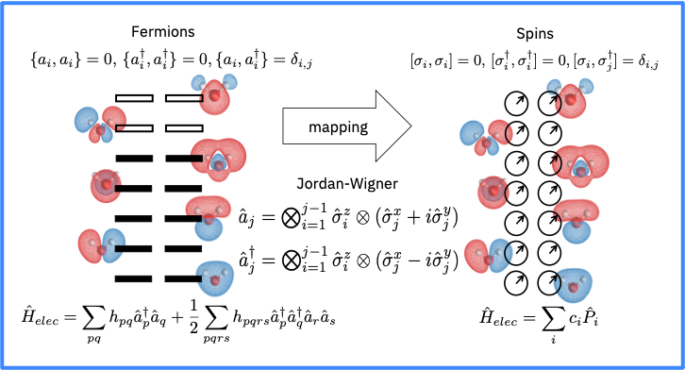
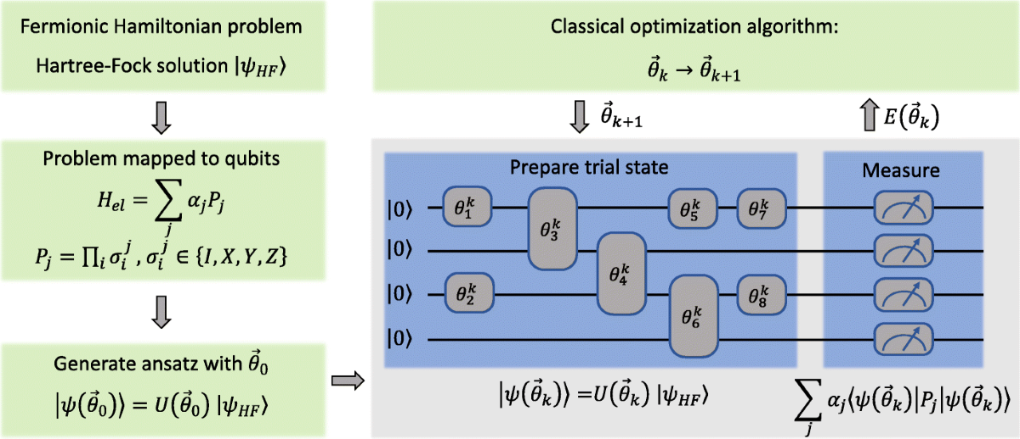
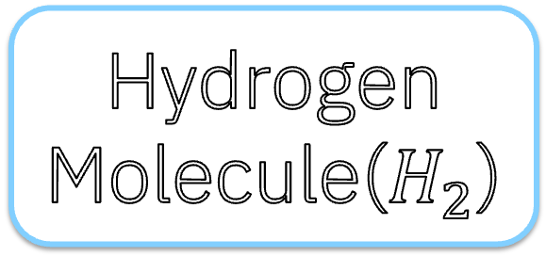
Process Map of ES Problem Solving for $H_{2}$Molecule with VQE
Hydrogen Molecule($H_{2}$)
Second Quantization
Map to Qubits
Hydrogen Molecule($H_{2}$)
Basis Set
First Quantization
Calculate Integrals
Jordan Wigner
Molecular Hamiltonian
Ladder Operators
Bravyi-Kitaev
UCCSD
Ansatz
Hartree Fock Calculation
Dissociation Curve
Exact and RHF
VQE
Initial State Preparation
Compare energies
Exact method
Apply Hamiltonian
Exact, RHF, VQE
Restricted Hartree Fock
Parameters

Slide 10
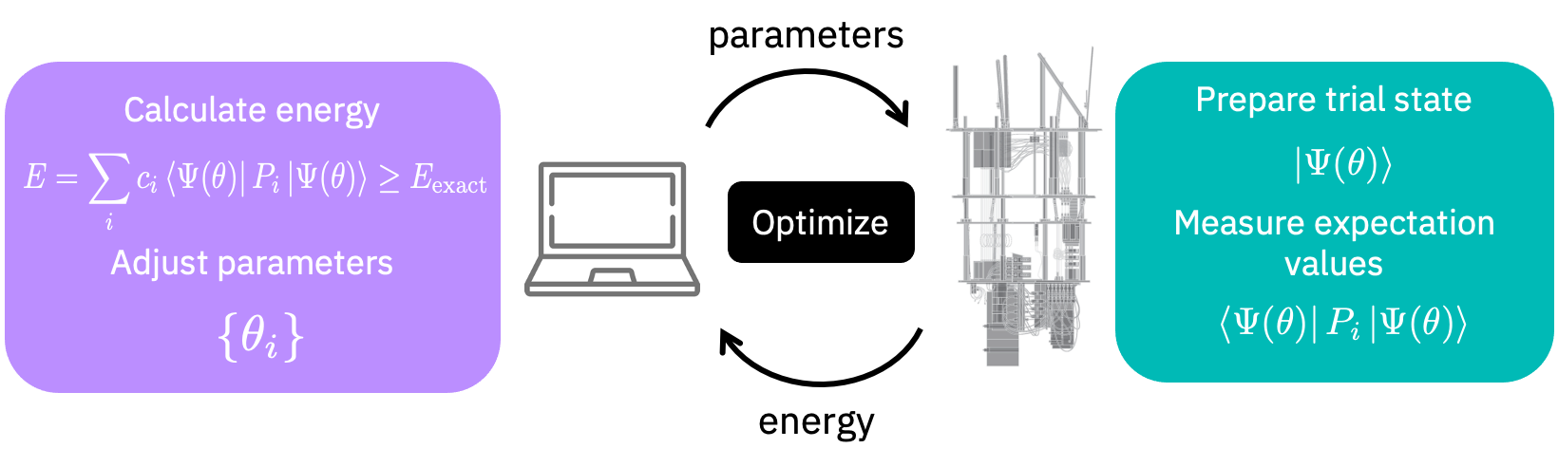
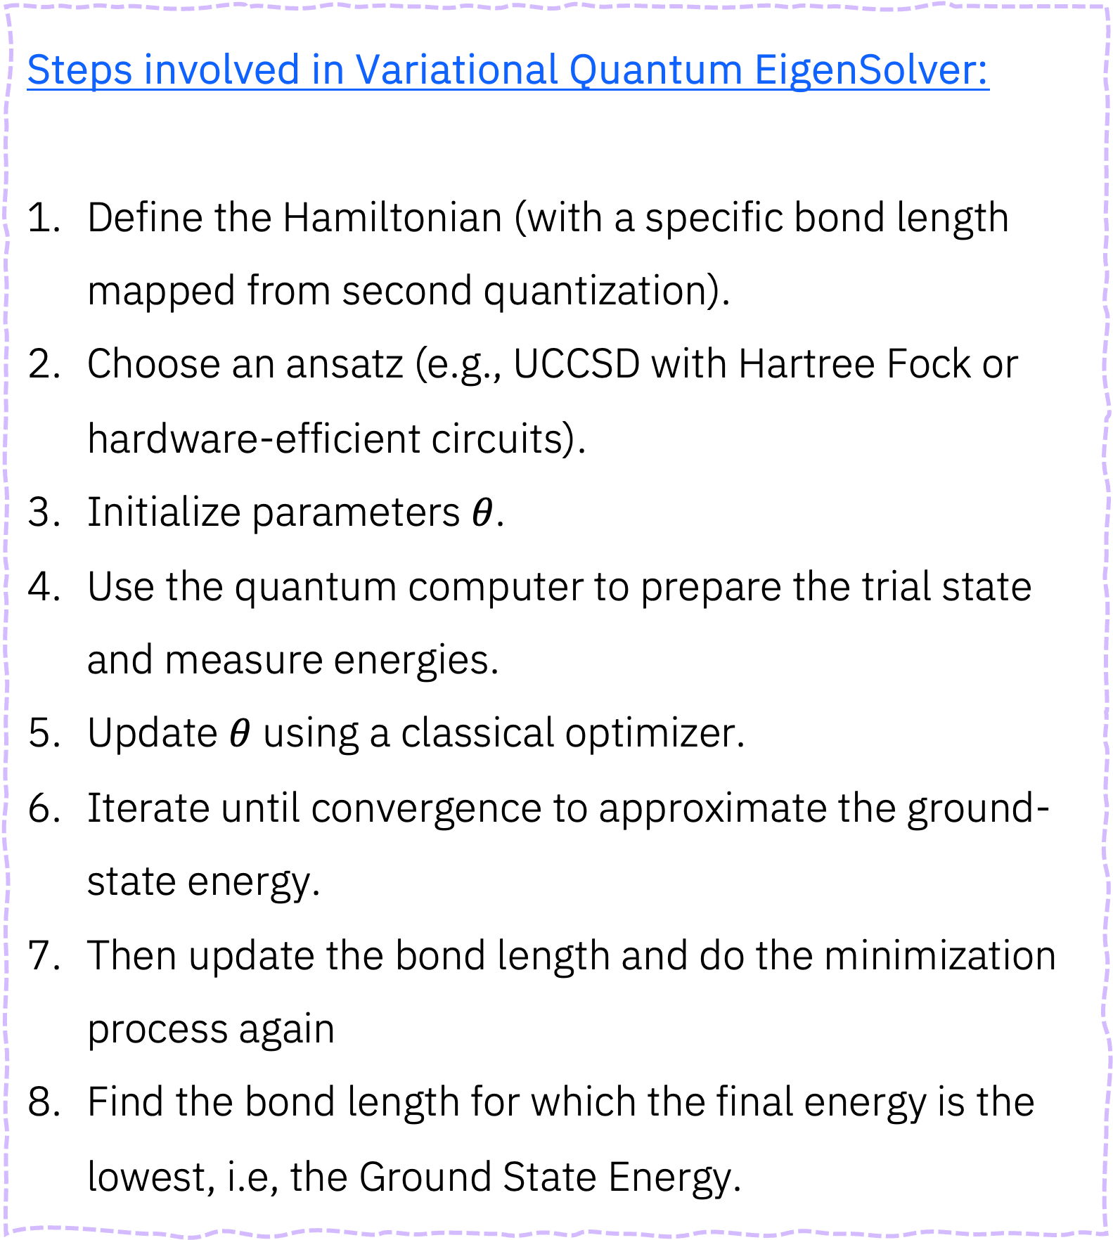
Variational Quantum Eigensolver Process
Steps involved in Variational Quantum EigenSolver:
Define the Hamiltonian (with a specific bond length mapped from second quantization).
Choose an ansatz (e.g., UCCSD with Hartree Fock or hardware-efficient circuits).
Initialize parameters $θ$.
Use the quantum computer to prepare the trial state and measure energies.
Update $θ$ using a classical optimizer.
Iterate until convergence to approximate the ground-state energy.
Then update the bond length and do the minimization process again
Find the bond length for which the final energy is the lowest, i.e, the Ground State Energy.

Slide 11
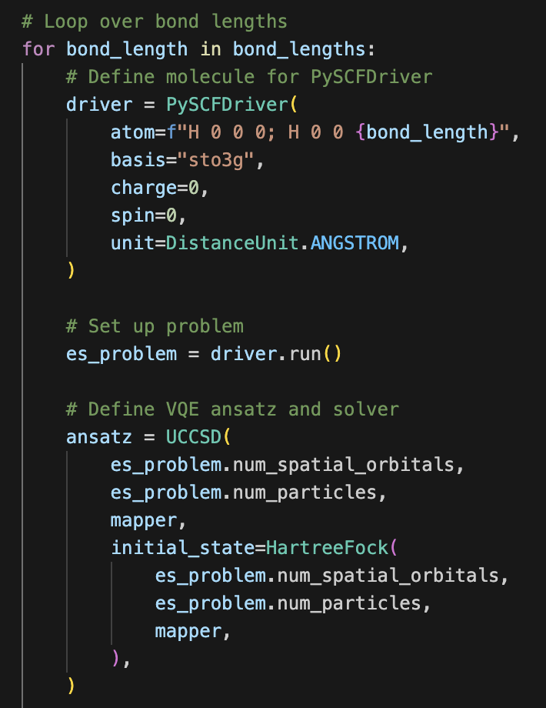
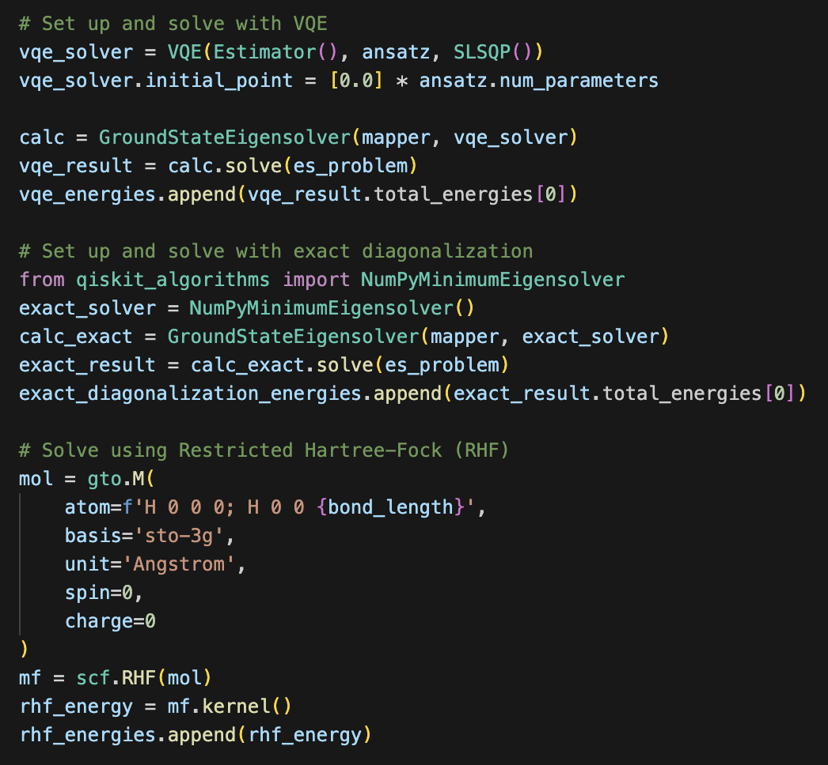
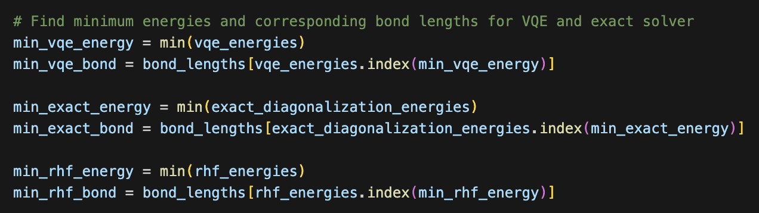
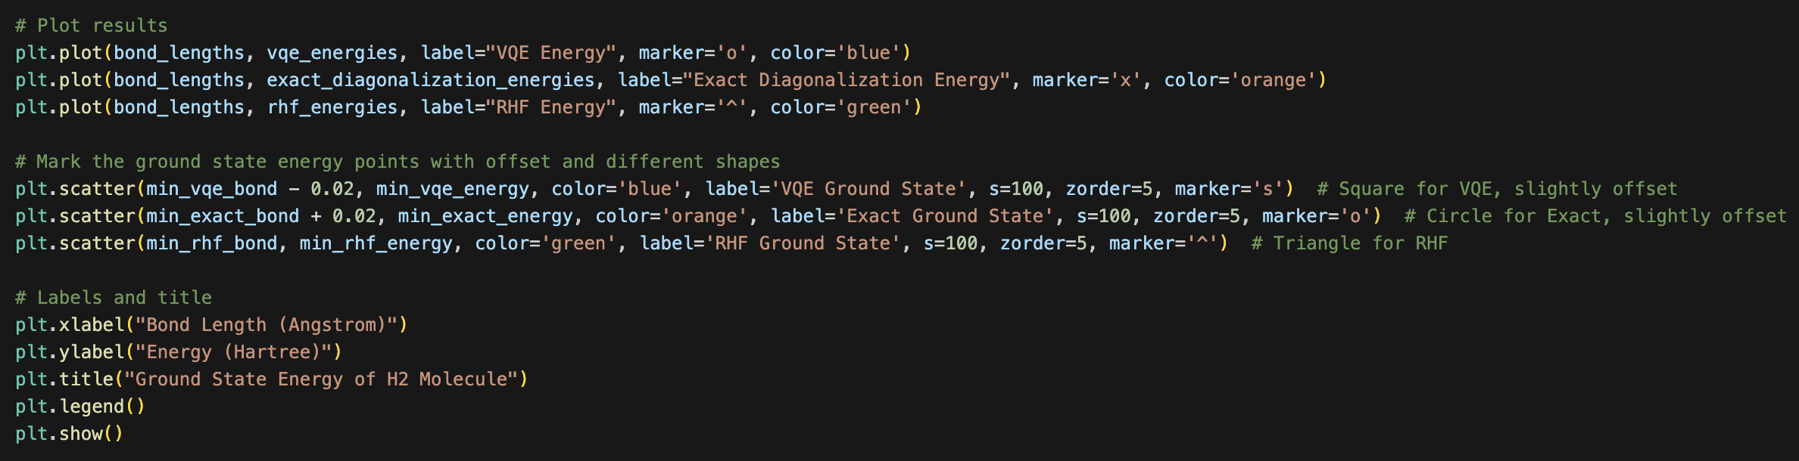
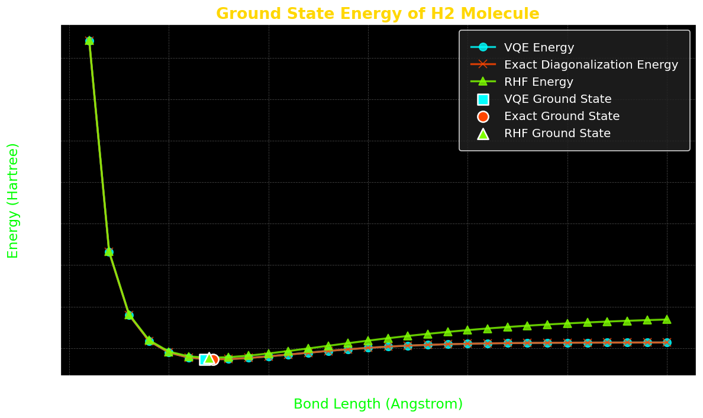
The VQE Code
1
3
6
Solving for Ground state energy using Variational Quantum Eigensolver
Calculating the minimum eigen value/ energy value throughout all the iterations over varied bond lengths
Looping over the bond lengths and creating the Hydrogen molecule with PySCF
4
7
2
Solving using Exact Diagonalization
Plotting the results
5
Creating the Electronic Structure problem with the molecule driver
Creating the initial state (ansatz)
Solving for Ground state energy using Restricted Hartree Fock Method

Slide 12
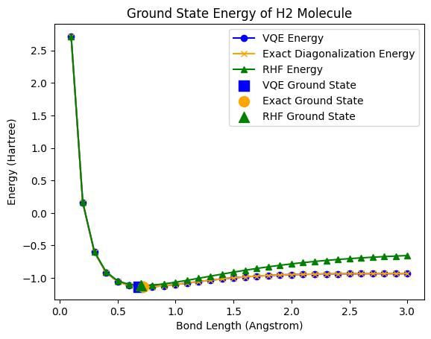

Results
Fig(1): Energy of the Hydrogen molecule as a function of Bond length or Bond distance(dissociation curve).
Method | Ground State Energy | Bond Length
Variational Quantum Eigensolver | -1.1136189 | 0.70 Å
Exact Diagonalization | -1.136189 | 0.70 Å
Restricted Hartree Fock | -1.117349 | 0.70 Å
The results compare VQE, Exact Diagonalization, and RHF for the ground-state energy of $H_{2} .$
VQE closely approximates the exact ground-state energy, outperforming RHF.
RHF overestimates energy due to its neglect of electron correlation effects.
RHF deviates significantly at larger bond lengths, while VQE aligns closely with exact results.
VQE demonstrates the potential of quantum algorithms for accurate molecular energy calculations.

Slide 13
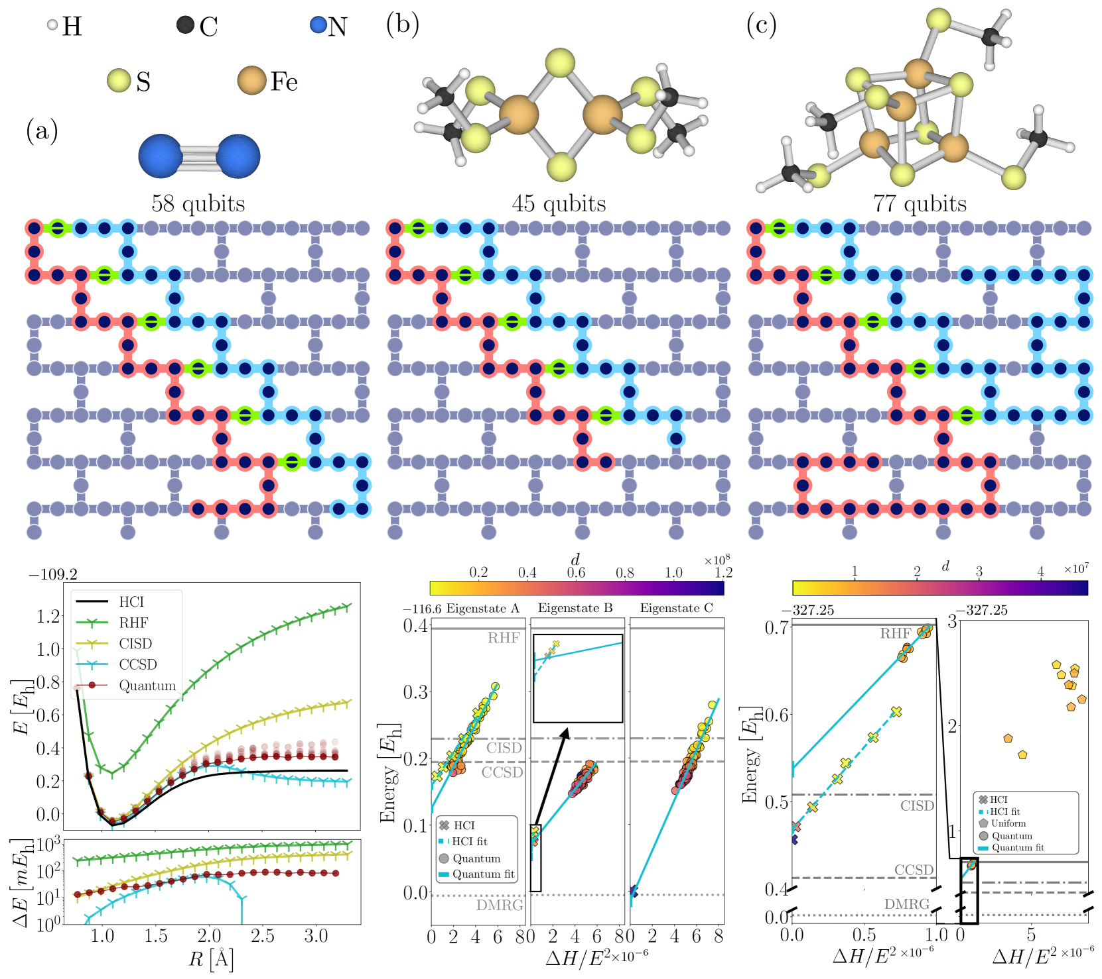
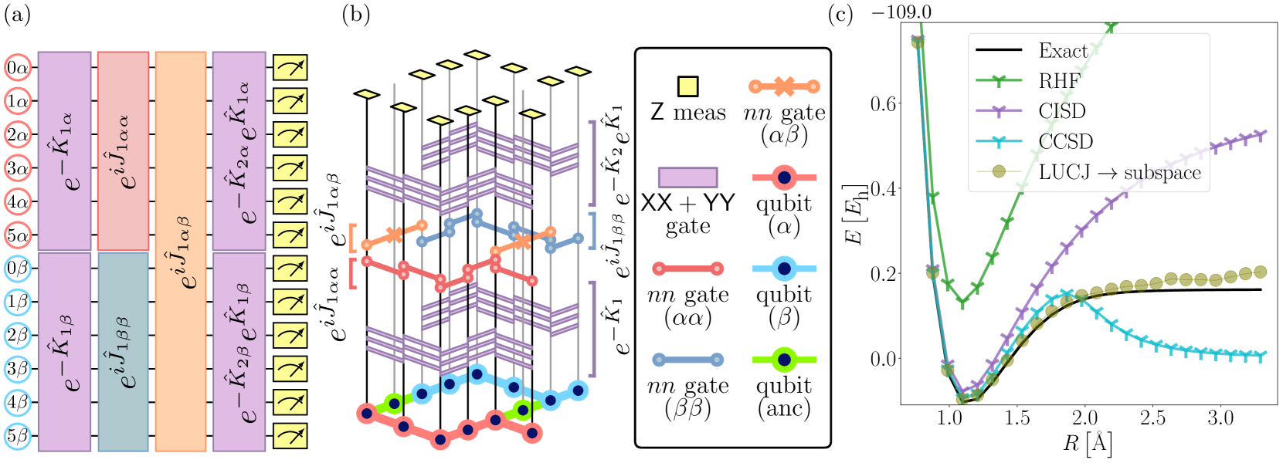
Further / Interested work
Incorporate Error Mitigation Techniques: Apply methods like Zero Noise Extrapolation (ZNE), Probabilistic Error Cancellation (PEC), and Phase Estimation Algorithm (PEA) to improve VQE accuracy.
Adapt VQE for Scalability: Exploring adaptive VQE variants to reduce circuit depth and optimize computational resources.
Krylov Subspace Methods: As a better alternative for QPE, investigate their integration with quantum algorithms to enhance convergence and capture excited states.
State-of-the-Art Quantum Chemistry: Leverage IBM's advancements in hardware-efficient ansatz and multi-reference methods for strongly correlated systems.
Novel approaches like Quantum Monte Carlo, Variational Hamiltonian Ansatz, and Tensor Network integration for quantum chemistry.
arXiv - 2405.05068v1
IBM Quantum, IBM T.J. Watson Research Center, Yorktown

Slide 14


